Slide 1
Public Relations – A Practical Guide
Aoife Forbes (eefa!)
Regional Image PR Manager inc. Tourism
One North East

Slide 2
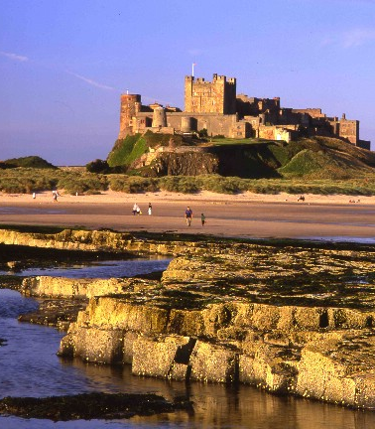
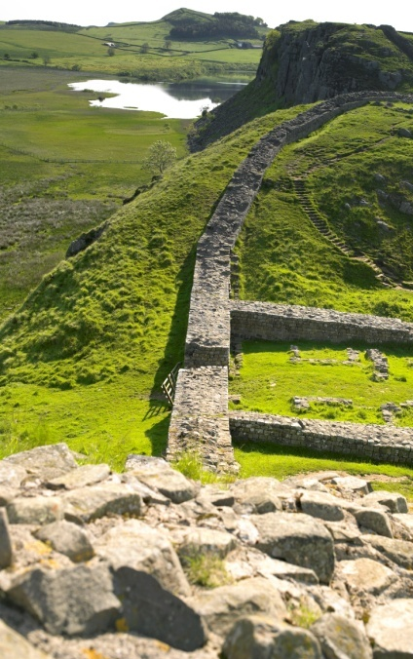
This Morning
Speaking today : Aoife Forbes, One North East
Karen Thomas, Tyne Tees TV
Session 1 – What is PR?
Session 2 – Reactive PR
Break
Session 3 – Broadcast and media
Session 4 - Promoting the Region
Top Tips Guide

Slide 3
My Background
PR agencies
Dublin, Newcastle upon Tyne
Luxury brands, many clients inc. Newcastle International
Postcode Lottery
Community lottery to raise money for local charities
Working very closely with local papers, learnt about ‘real’ region
One North East, my role – promoting region as place to visit, live, work, study, invest, recommend, represent and be proud of
Children North East Charity
Simple ideas, no budget, restrictions

Slide 4
What is PR?
Put simply – PR is selling. An idea, a product, a place, a person, to a particular audience, through TV, press, internet, radio
Journalists middle-men in getting our ‘product’ across
The way this ‘product’ is sold to the people we want, depends on how we ‘sell’ it
Advertising V Public Relations
Both are marketing tools, but can be seen as separate skills
Advertising is paid for, editorial is free
Editorial more influential – like recommendation from a friend we trust

Slide 5
Why do PR?
Helps ‘sell’ product, but subtly, with associated key messages
Credible - an ad can say a school has great teachers, a good record and a huge swimming pool – but an education writer can compare it against others and really endorse it. Which will be believed and trusted
More affordable than other options
Helps build relationships which can help in times of need

Slide 6
Preparing for PR activity
Do your homework – what is local paper, who is main writer, who reads it, what kind of stories do they cover?
Become aware of local media and read paper everyday
What do you want your audience to know about your school?
Think about your school – what makes it unique?
Look out for juicy stories – befriend the school busybody, enlist the help of colleagues, keep up with news
If there are no juicy stories – create them yourself! Can you add something creative to the photo?
Test ideas out on friends and family – do they find them interesting?

Slide 7
Preparing for PR activity
Develop a calendar/ timetable of known milestones that press will be writing about regardless and will need stories for.
For example: GCSE results, nativity plays, OFSTED results
Try and do their work for them and give your story first
Also add your calendar, things that are unique to your school to tell press. For example: special trips, community projects, teacher retirements, anniversaries, new senior staff
Examples of these types of stories in your pack

Slide 8
Preparing for PR activity
Don’t forget school policy about parent consent for kids in photos, hard hats on building sites, dress codes etc…
Make sure you forge links with your local council. Find out who the PR/ Communications contact and try to meet them or simply write to introduce yourself (more later)
Most contact details are available on council websites
Make sure all staff know you are the school PR rep and if any enquiries come in – you are the person to deal with them

Slide 9
Proactive PR - Idea to Paper
A press release is a short written piece of copy normally emailed to journalists
There is a strict format to this, the first paragraph should sum up the whole story (examples in pack)
Make sure to cover what, who, why, how, where, when
Keep it concise, short paragraphs, put in quote from a suitable high-level person in 3rd/ 4th para
Always add a photo if you can, with the person quoted
Photos can really help get coverage – get creative!
Examples in pack….

Slide 10
Proactive PR
If it is about an event, invite the newspaper to come and take a photo which you set up
Always tell press before – not after!
Don’t forget to add in your contact details
Try and do as much work for press, huge job cuts in newspapers especially
Don’t be afraid to just pick up the phone and chat
Don’t get too bogged down informalities – building relationships is more important
Press work is not clock in, clock out – never turn press down!

Slide 11
09 October 2008 PRESS RELEASE
TOP LONDON 2012 OFFICIAL PAYS VISIT TO TYNESIDE
Leading London 2012 official, Charles Allen CBE was in North Tyneside today to meet with young people who have been demonstrating their sporting and educational prowess.
Charles, Chairman of the London 2012 Nations and Regions Group (NRG) and London Organising Committee of the Olympic Games and Paralympic Games Board Member, visited the Percy Hedley Academy for Disability Sports in Killingworth and Marden High School in North Shields to chat with children and learn more about their programmes and facilities.
His day began at the North East England Regional Forum for the London 2012 Olympic Games, at which the region’s NRG representatives and London 2012 Consortia members discussed the North East’s Olympians and Paralympians successes in Beijing 2008 and the regions plans to maximise the benefit from London 2012.
Tanya Gray, Nations and Regions Co-ordinator for the North East and One North East Sports Specialist Advisor, said: “This morning’s meeting went extremely well, with discussions highlighting a number of the region’s Olympic achievements such as the inclusion of our regional facilities into the London 2012 Pre-Games Training Camp Guide for the Olympic and Paralympic Games and the promotion of the CompeteFor website, London 2012’s online dating agency for businesses.”
“More than ever, the North East is in a position to benefit from the London 2012 Games and our aim is to make these benefits available to everyone here in the region.”
Continued……

Slide 12
Photocall
Photographic and interview opportunities will be available with Charles Allen at the Percy Hedley Academy for Disability Sport. Media call at 2pm – with a focus on the Paralympics. Attendance is welcome at a Paralympic sports display, scheduled to begin prior to the media call at 1:30pm.
Photographic and interview opportunities will be available with Charles Allen at the Marden High School media call at 3pm – with a focus on the ‘Get Set’ programme. Attendance is welcome from the start of the visit at 2:30pm.
Please confirm attendance to Andy Aston, press office, One North East on Tel: (0191) 229 6894; Mob: 07766114798 or e-mail: andy.aston@onenortheast.co.uk

Slide 13
Some tricks of the trade
Letters to the Editor
Keep ear to the ground for local news – free council newsletters, free sheets, events on supermarket notice boards
Use photography well, make sure to add caption
Look ahead to national events such as new research, white papers, new statistics and trends
Try and thank journalists afterwards
Be as open, honest and helpful as possible
Personal suggestion for photographer: Dave Webb 01670-735333/ 07770 396 173
Personal suggestion for further PR and Media training:
www.rowntreegordo.co.uk 0191 215 5014

Slide 14
Reactive PR
What happens if the story comes to you?
First of all, keep cool, calm and collected
Try to anticipate any tricky stories that might come up
In advance prepare a ‘holding statement’ about the issue
This needs to be a quote from the most appropriate person, which is safe and does not add more fuel to fire
Try to keep it focussed and relevant
Brief all staff about the story, especially the front of house staff
Make sure you are the single point of contact for all press – you want the same message going to everyone

Slide 15
Reactive PR
Choose what you get involved with – it is really something you need to make a comment about? Maybe it is about an ex-pupil or teacher….
In this case the best line is: ‘The fact that they (went to school here) is not relevant to the issue.
Not ‘no comment’!
If there is a very contentious issue, work very closely with your local council for support and advice
Decide if the issue is about just your school (you), your area (council) or the North East generally (Schools North East)

