Slide 1
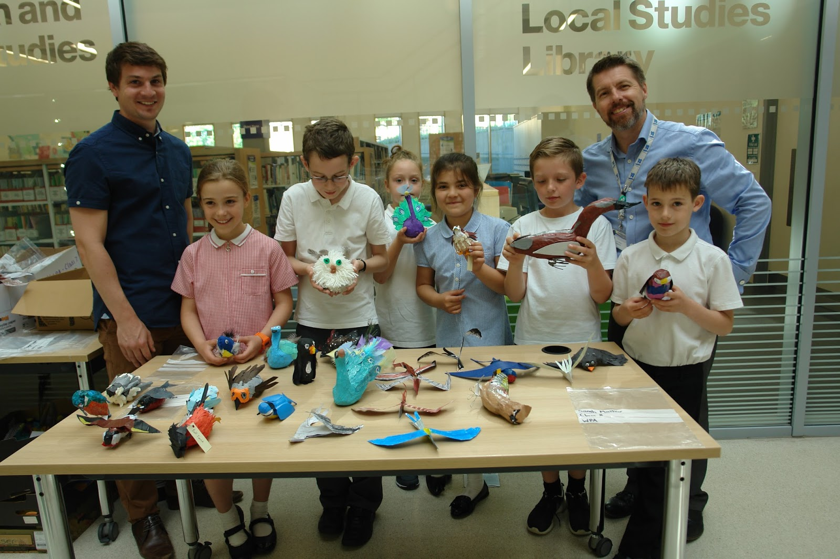
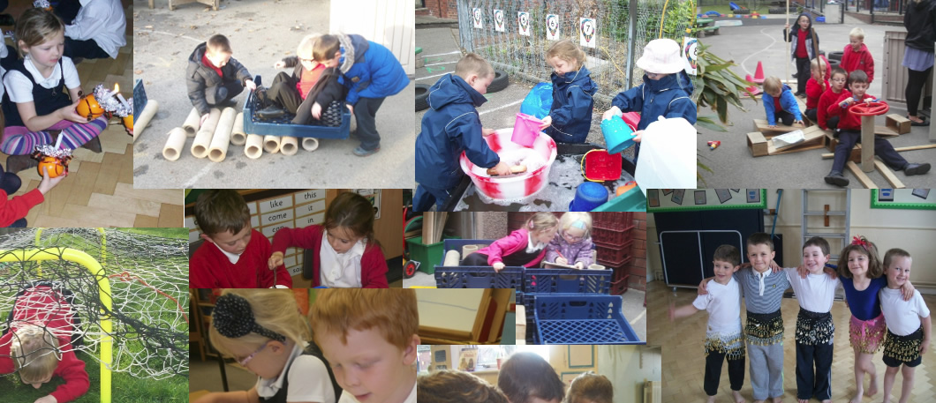
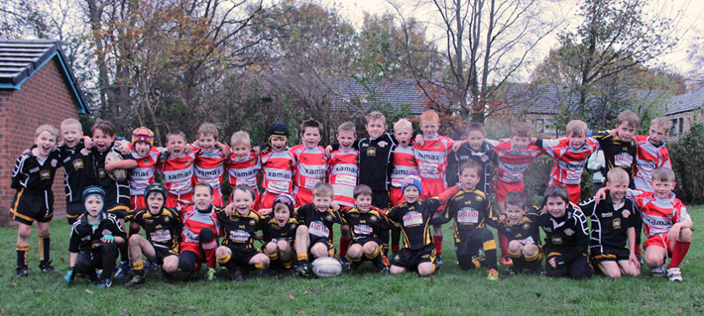

MATch Making , What to look for when joining a MAT
WHERE SUCCESS IS A SHARED experience

Slide 2


I’m Not!

Slide 3
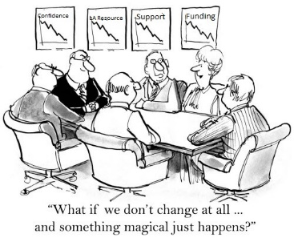


Turn a dilemma in to an opportunity !
No longer Will We!
When
Who
What

Slide 4
Why form or join a MAT?
National Context
LA inability to support.
Self determination & creation of an egalitarian model
Greater Autonomy: educational/ services/financially !
Opportunity to make an impact.

Slide 5
The System in Capacity Terms
Total Number of Academies in the system as of the end of May
  5719 in total with 19% of Primary and 66% of Secondary
  304 Free Schools
  40 Studio Schools
  39 UTC
  Total Number of Sponsors is 853
  128 in WM and SESL and 58 in the North
  Total Number of MATS is 973
  Total Number of Teaching Schools is 735
  LWY has 121 and SESL has 112
  Total Number of NLE is 1114
  Total Number of NLG is 439

Slide 6
The System in Capacity Terms
Focus on Multi Academy Trusts
We know there are 973 across the 8 RSC regions
Size and Scale
  681 have between 1 and 3 schools (69.9%)
  185 have between 4 and 6 schools (19%)
  74 have between 7 and 12 schools (7.6%)
  20 have between 13 and 25 schools (2%)
  13 have more than 25 schools (1.3%)

Slide 7
The System growth model
Starter Trusts
  1-5 schools
  Up to 1000-1200 students
  Within single LA and Region
Established Trusts
  5-15 schools
  Up to 5000 students
  More than one LA and likely to be single region
Regional Trusts
  15-30 schools
  Approx 10000-12000 students
  Likely to be in more than one region
System Trusts
  30+ schools
  12K students and beyond
  Working across the system in 3 or more RSC regions

Slide 8
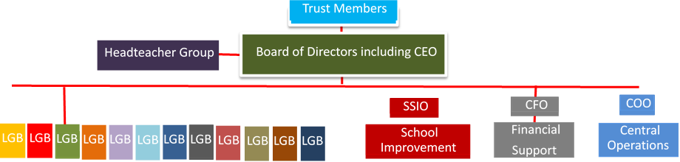
The structure
Board of Trustees
CEO

Slide 9

Due diligence !
Converting school responsibility
Trustee responsibility
CEO responsibility
SSIO responsibility
CFO responsibility
COO responsibility

Slide 10
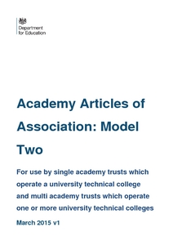

Key Documents ?

Slide 11
challenges
The requirement for growth
CEO required
Increased administration.
Perceived competitor element / developing partnerships
Standards not sturctures
Political agendas

Slide 12
Typical trust non negotiables
Annual Contribution
HR Services
Premises Compliance Arrangements
Finance Compliance Arrangements
Assessment Reporting Arrangements
ICT Support
Admissions

Slide 13
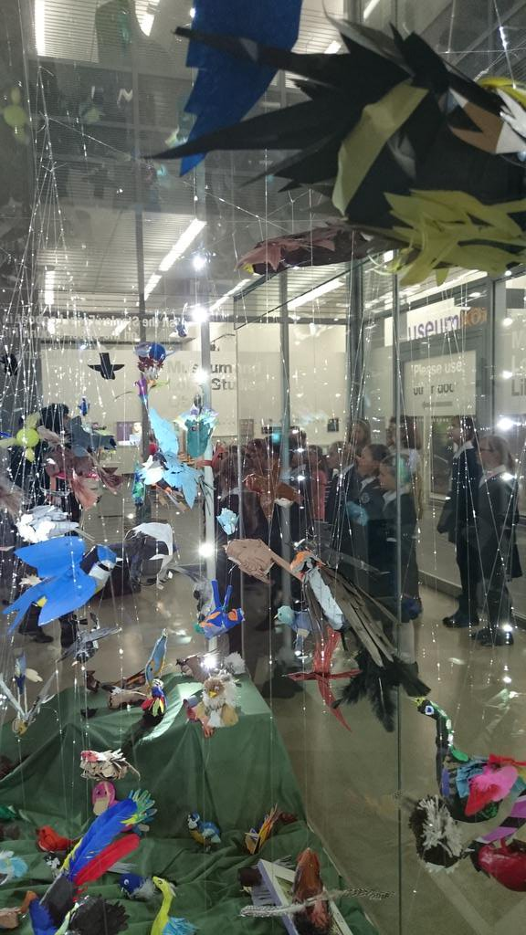


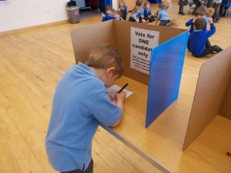

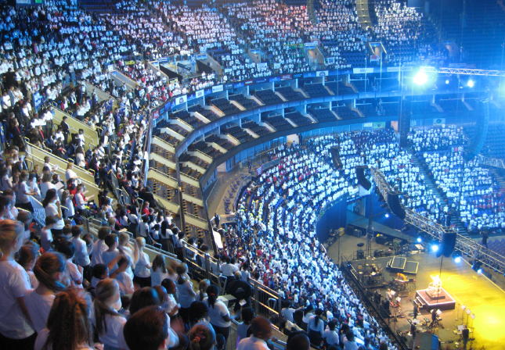
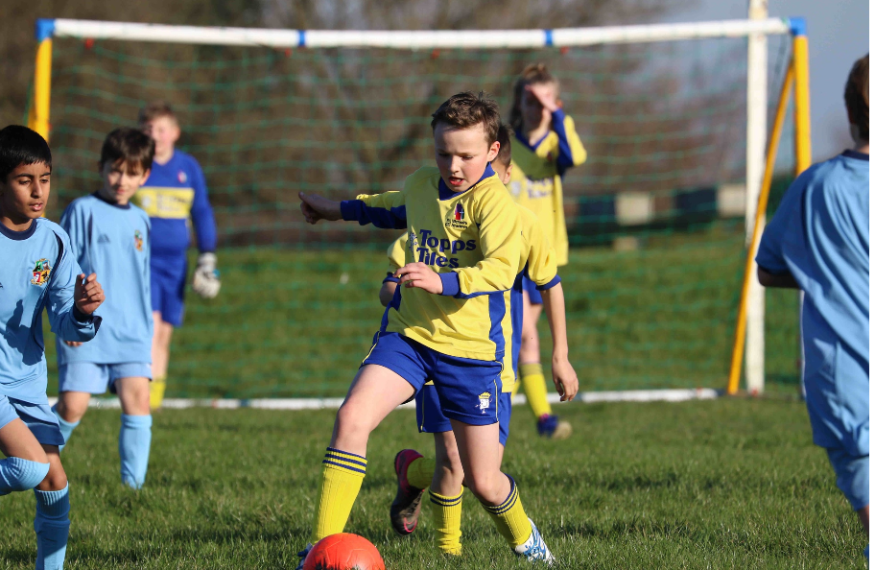
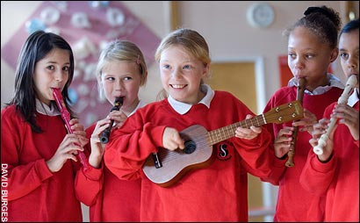
WATERTON ACADEMY TRUST in action

Slide 14
In Conclusion
Debate around if is over
Self determination is still an option
Due diligence and consultation are a must
Articles and schemes are crucial
The sum of the whole can be greater than its parts
Collaborate with likeminded organisations or not
Park the politics and promote the child
LA can stand for Life After

Slide 15

ddickinson@watertonacademytrust.org

