Slide 1
MASSIVE Goal
My Massive Goal(s) for you from this session:
I inspire you to take your first step to boosting your own resilience and give you the means to achieve it.
TODAY

Slide 2
5 Steps to Boosting Resilience
Welcome
Janie Lambeth
Notes:
Intro Janie
Resilience – why we need it
Resilience – learnable skill
We choose the life we live
Proactive

Slide 3
Step 1 – Know yourself

Slide 4
Step 2 – LOL

Slide 5
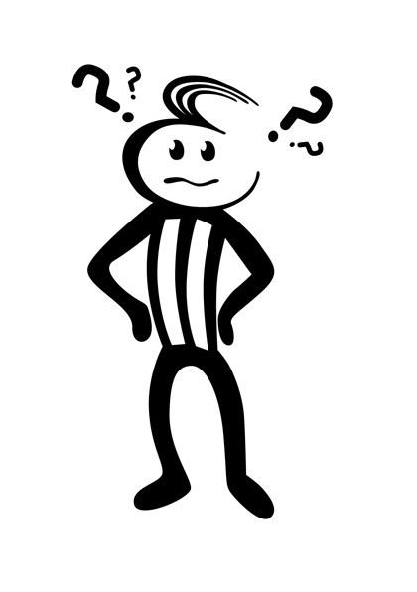
Step 3 – Thinking Traps
Tunnel Vision
Jumping to conclusions
Mind Reading
Black and White
Maximising/Minimising
Shoulda, Woulda,Coulda,
Personalisation
Externalising
Over-generalisation
Emotional Reasoning

Slide 6
Step 4 – Anchors
Notes:
What is an anchor
How relate to building resilience
Examples
Use natural ones and create new ones
Challenge – find one and use it

Slide 7
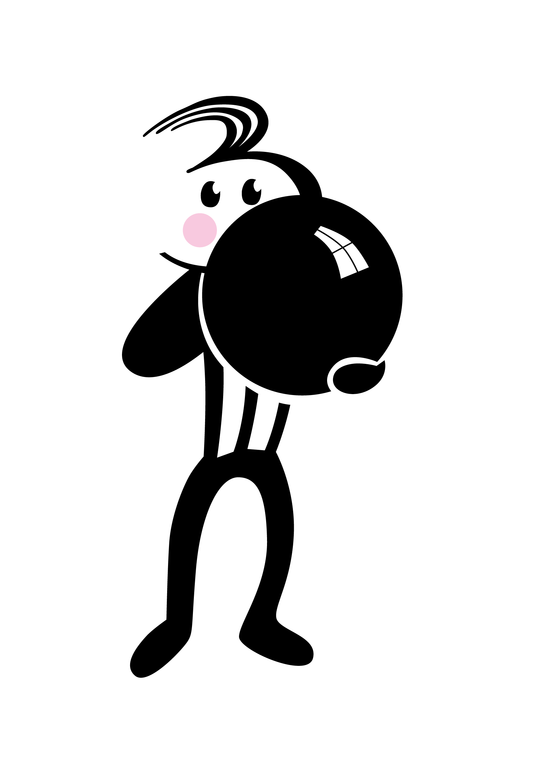
Step 5 – Take a Deep Breath

Slide 8
Questions
For a copy of the delegate notes please go to
www.threedomsolutions.co.uk/conference17

Slide 9
Set Your Goal
Key points to remember:
Be honest
LOL
Question your thinking traps
Find your anchors
Take a deep breath

