Slide 1
SCHOOLS NorthEast’s FutureReady Conference 2016
Thursday 4 January 2016
Gill Collinson
Head of Centre – National STEM Learning Centre and Network

Slide 2
My Journey
UNIVERSITY
Applied Physics
SCHOOL
Maths, Science, Music, PE
ENGINEERING DESIGN
Electrical Engineering and Power Industry
STEM EDUCATION SUPPORT
ENGINEERING MANAGEMENT
Product development and high volume manufacturing

Slide 3
STEM Learning Ltd
STEM Learning manages:
the network of Science Learning Centres/partnerships on behalf of the Wellcome Trust and the Department for Education;
the National STEM Centre on behalf of the Gatsby Foundation;
a number of other STEM programmes;

Slide 4
Range of STEM programmes of support
Notes:
Myscience:
Established in 2004 by the Universities of York, Leeds, Sheffield and Sheffield Hallam, Myscience is developing and supporting teachers, technicians and others working in STEM education
Myscience manages:
the National Science Learning Network on behalf of the Wellcome Trust and the Department for Education;
the National STEM Centre on behalf of the Gatsby Foundation; and
a number of other STEM programmes.

Slide 5
STEM Learning Ltd –
From 1st January 2016, the National Science Learning Centre and the National STEM Centre will offer support to schools and colleges under a single brand – the National STEM Learning Centre & Network.
A key aspect of our work to simplify our offer has been the recent successful launch of a new, unified website www.stem.org.uk, which brings together all elements of our work.

Slide 6
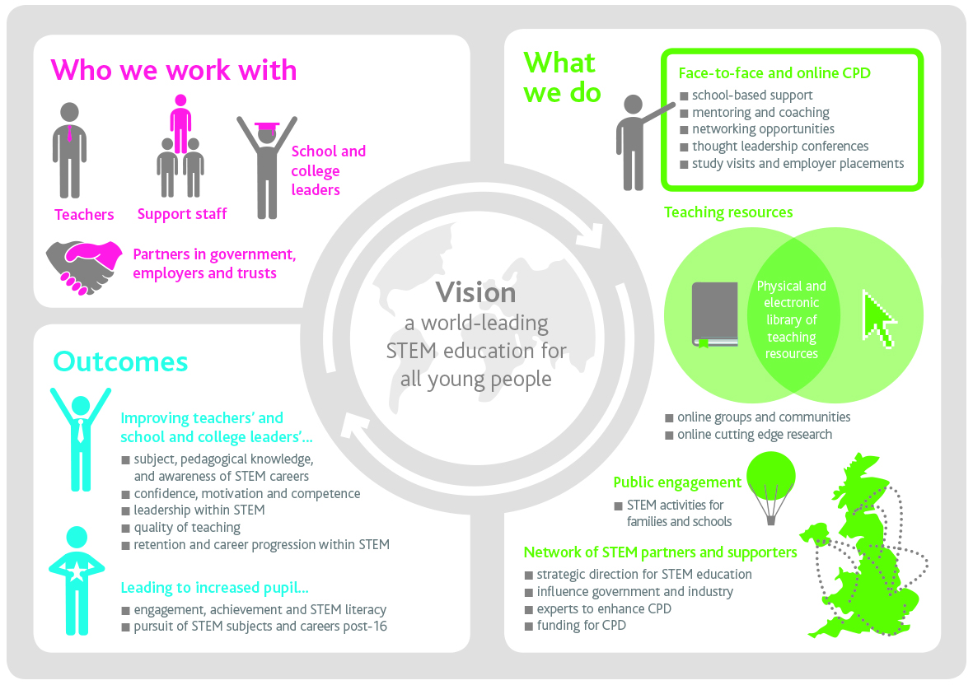

Slide 7
STEM Learning Ltd –
Our offer will include:
Curriculum-linked, quality-assured STEM teaching and career resources, physically and on-line;
Community groups, peer-to-peer support, online professional development and networking opportunities;
Local, high impact, subject-specific professional development through Science Learning Partnerships in England, and partners in Scotland, Wales and Northern Ireland; and
Sustained, transformational, STEM-specific professional development, including residential experiences.

Slide 8
Good Careers Guidance: Eight benchmarks for effective Careers Guidance
Stable careers programme
Learning from career and LMI
Addressing the needs of each student
Linking curriculum learning to careers
Encounters with employers and employees
Experiences of workplaces
Encounters with FE and HE
Personal guidance
Notes:
The Gatsby Foundation has published a report by Sir John Holman of York University, examining what pragmatic actions could be taken to improve career guidance in England’s secondary schools and colleges.
▪ Six countries were studied where both career guidance and educational results are good – the Netherlands, Germany, Hong Kong, Finland, Canada and Ireland - as well as five independent schools in England.
▪ Eight benchmarks were developed that identify different dimensions of good career guidance:
 A stable and embedded programme of career education and guidance, known and understood by pupils, parents, teachers, governors and employers.
 Good quality information about future options and opportunities, supported by informed advisers.
 Opportunities for advice and support tailored to individual needs.
 Curriculum learning linked with careers.
 Multiple opportunities to learn from employers about work, employment and valued skills.
 First-hand experiences of the workplace through visits, shadowing and/or work experience.
 An understanding of the full range of available learning opportunities in a range of settings.
 Opportunities for guidance interviews with an internal or external, appropriately trained career adviser
▪ A survey of secondary schools found that none fulfilled more than five of the eight benchmarks, but many partially fulfilled them and didn’t need to do much to get there.
▪ PricewaterhouseCoopers estimates the cost of implementing the benchmarks across England as £207m in the first year and £173m per annum thereafter.
 The avoided cost of one less pupil becoming NEET would be enough to provide career guidance to the benchmark level for 280 pupils.
 Shorter term benefits also accrue, including better motivation and higher attainment.
▪ Ten recommendations include: every school being required to have a published Careers Plan; the remit of the National Careers Service (NCS) being extended to schools; every school having a governor responsible for encouraging employer engagement; existing ‘young ambassador’ programmes being extended.

Slide 9
ECB – inGenious (2011-2014)
A multi-stakeholder European programme in STEM education
Initiated by
European Schoolnet
and
European Roundtable of Industrialists
to address economic and political concerns about the future of the European STEM workforce
Brought together educators and businesses:
17 multinational companies
5 industry associations
18 public bodies and universities
focused on STEM careers and industry-school collaboration
co-financed by the EC and industry partners (€ 8.3 M - 50/50)

Slide 10
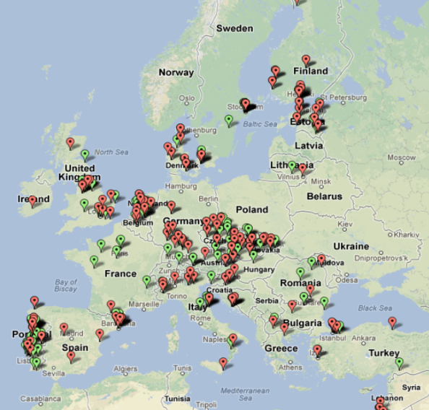
ECB – inGenious (2011-2014)
Researched
School – Industry partnerships (Theory /Practice/ Needs Analysis)
views and attitudes of students and teachers + factors influencing career aspirations
Tested and evaluated existing innovations in STEM education
Created new innovative activities in STEM education, career advice and teacher development (face-to-face and online)
Created a European repository of educational activities and programmes in STEM subjects developed by industry partners (http://www.ingenious-science.eu/web/guest/practices)
Developed a broader network of inGenious community partners

Slide 11
Ingenious – what students and teachers told us ….
41% of students said that they DO NOT learn about jobs and career opportunities in school (49% in UK!)
79% of teachers said their pupils knew little about job opportunities in STEM subjects
97% of teachers believed in the necessity of teaching STEM in a real-life context
96% felt that they need to know more about recent scientific discoveries and industrial applications
During 3 years preceding the project 45% of schools had no experience in running a hands-on activity provided by industry while 58% said that did not carry hands-on activities in which an industry representative participated

Slide 12
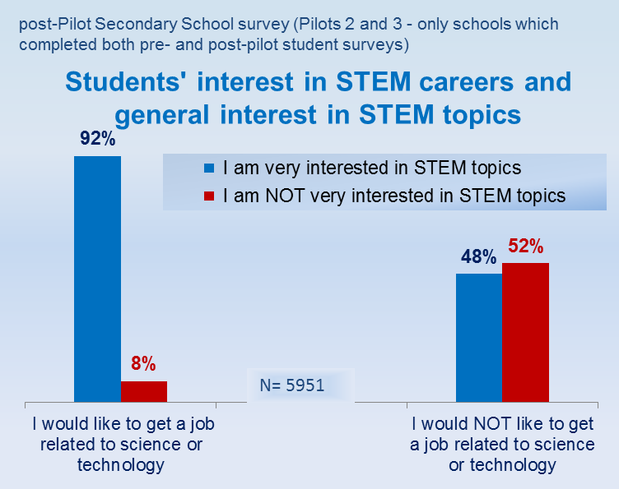
Ingenious – what explains student career choices?
Interest in STEM
Interest in STEM subject and enjoyment of lessons
is a necessary pre-condition for career aspirations,
yet it is not sufficient and many young people, especially girls, who generally like STEM, don’t think of it as their future career choice
Learning about STEM careers
 | I would like to get a job related to science or technology
n=14141 |  | disagree | agree
I don’t learn about STEM careers in school |  | 57% | 43%
I learn about STEM careers in school |  | 37% | 63%
School experiences of learning STEM subjects and receiving career advice are very important in moving STEM interest into career aspirations
+20%
Notes:
Link between subject and career interest – it is necessary but not sufficient but need to have career element in addition to good teaching and learning

Slide 13
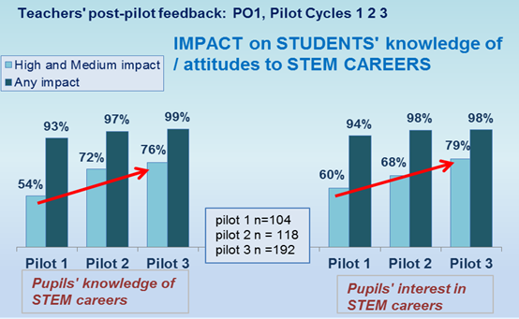
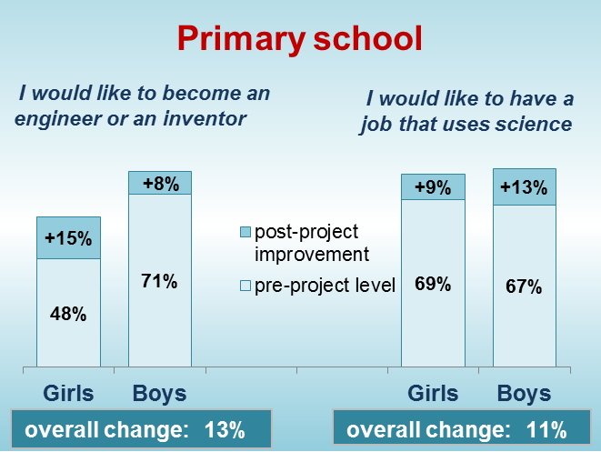
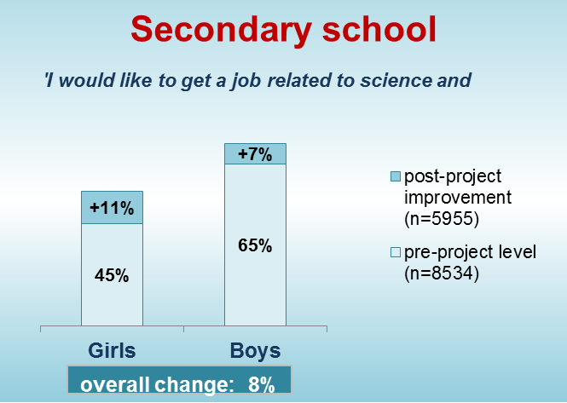
Evaluation results: inGenious achievements
Long-term impact on pupils' interest in STEM careers
Notes:
The project improved teachers and teachers reporting impact on pupils – improving year on year and verified by pupils surveys

Slide 14
Key messages…..
Interest and enjoyment of STEM subjects are necessary pre-conditions for STEM career motivation of students, but learning of STEM careers and real-life applications of knowledge are crucial for raising student aspirations towards STEM careers, especially among girls.
STEM education has to be contextual (with real life examples and career learning) and multi-dimensional (with different types of industry initiatives supporting the learning)
inGenious helped teachers recognise that collaboration with industry partners is a catalyst for change
To provide high quality learning of STEM subjects and careers schools need external support from industry and business as part of long-term collaborations
This support has to include not only learning activities and resources, but opportunities for professional learning and networking for teachers and industry experts.

Slide 15
Enthusing young people is vital – but teachers remain key
Three things make a difference to increasing young peoples interest in STEM study and careers
Sustained CPD for teachers about careers awareness (aligns to Benchmark 4)
Access to STEM experts for teachers and pupils (aligns to Benchmark 5 & 6)
Careers and contextual information embedded in curriculum (aligns to Benchmark 4)

Slide 16
National STEM Learning Centre and Network
Sustained CPD for teachers - subject specific CPD with careers awareness embedded into the curriculum
CPD and bespoke support for schools and colleges from experienced STEM education professionals
Access to bursary funding

Slide 18
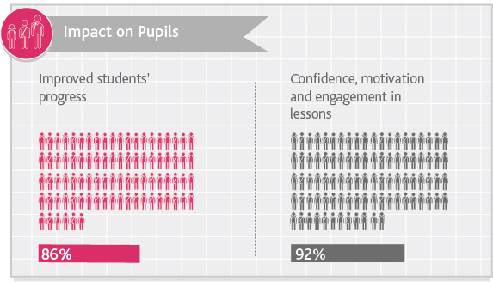
Impact on pupils

Slide 19
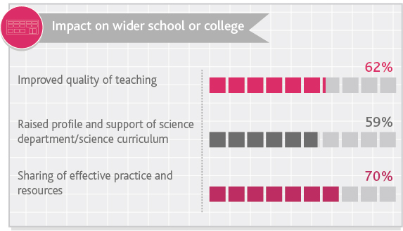
Impacts on the wider system

Slide 20
National STEM Learning Centre and Network
Access to STEM experts for teachers and students
Signposting to key sources of support on the web
STEM careers resources and labour market information.
An online community forum to access up to date reports and discussion on STEM careers-related learning

Slide 21
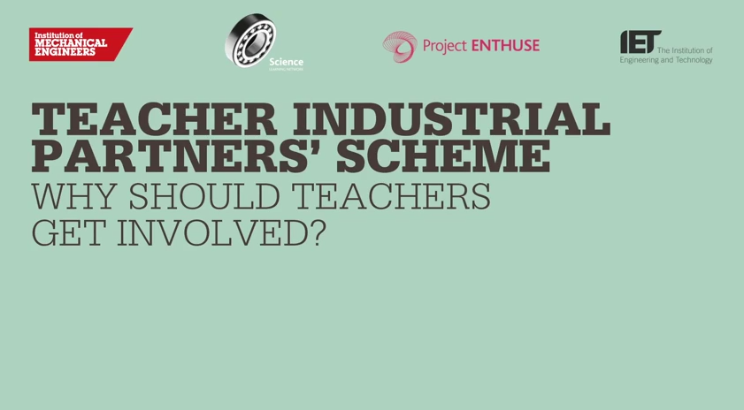
Teacher Industry Partners’ Scheme (TIPS)

Slide 22
TIPS
TIPS enables teachers to have a meaningful, structured experience within a STEM employer, where they have time and opportunity to experience the breadth and depth of careers, as well as the ways STEM is used.
Inspired by the IMechE, supported by IET
Now part of the STEM Learning Ltd. offer, supported by Project ENTHUSE
Has real potential to be a ‘game changer’ if we can build to large enough.

Slide 23
Why is it so important?
“82% of teachers think they are lacking the necessary knowledge to properly advise young people…. one-fifth of parents admitted they believe they are out of their depth when it comes to talking to their offspring about career prospects.” AoC 2012
“nearly 53 per cent of teachers do not feel confident giving advice about apprenticeships. In contrast, more than two- thirds said they were very or quite confident advising students about university study.” EET/TES survey 2012
Notes:
The Science Learning Centres network

Slide 24
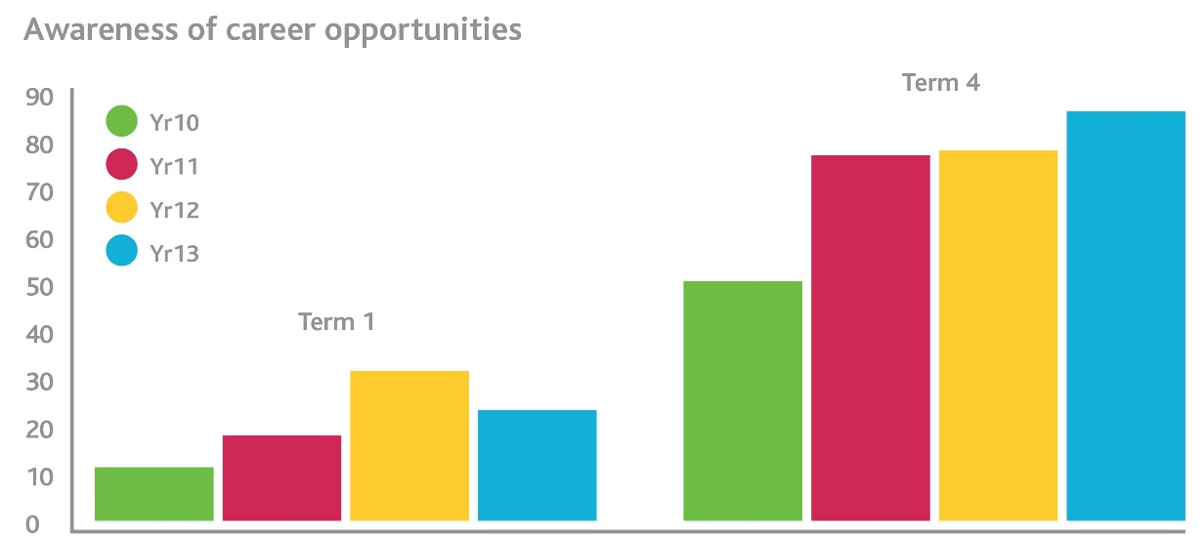
Teachers engaged in Teacher Industrial Partners’ Scheme (TIPS) were:
More confident in talking to students about careers in science & engineering
More able to use appropriate practical examples in lessons
Improved understanding of breadth & depth of STEM careers
More confident in discussing apprenticeships & vocational routes with young people, colleagues & parents.
King 2015
Source: David Sandall TIPS participant 2014

Slide 25
National STEM Learning Centre and Network
Careers and contextual information embedded in curriculum
Newly launched website with dedicated resources and support for subject teachers/lecturers to embed STEM careers into the curriculum
STEM Planning Tools – help with practical approaches to embedding STEM careers awareness across schools and colleges
Development of resources which embed careers directly into the curriculum. (pilot phase close to completion)

Slide 26
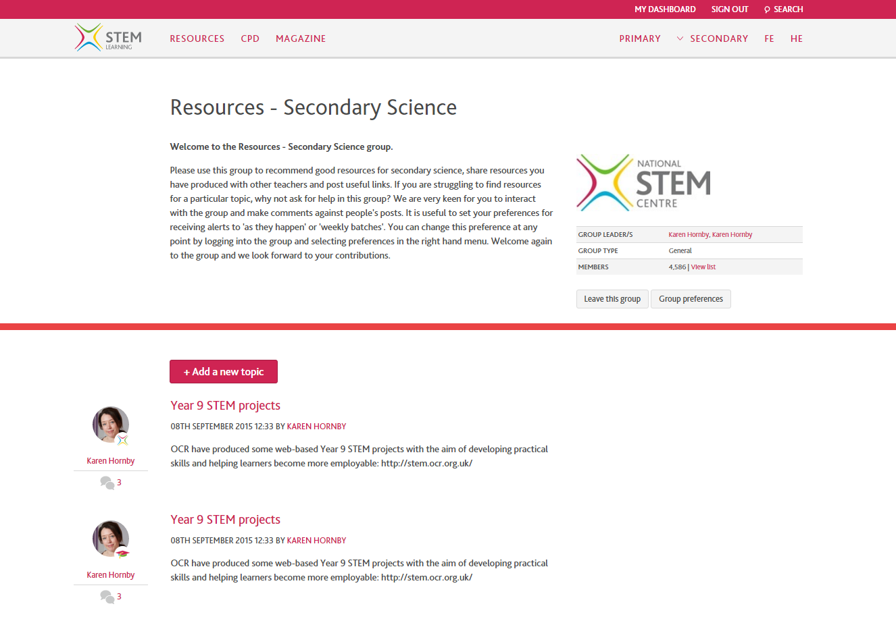
A range of online support – resources, CPD….

Slide 27
Enthusing young people is vital – but teachers remain key
“No education system can exceed the quality of its teachers.” – McKinsey, 2007
“The future of science depends on the quality of science teaching today.” – Wellcome Trust
“The best science teachers … set out to ‘first maintain curiosity’ in their pupils.” - Ofsted, 2013.

Slide 28
Concluding thoughts
STEM subjects are for everyone – regardless of what they do with it
STEM subjects offer great career and real choices
Teachers are key – they need and deserve career-long, subject-specific support
Thank you for everything you do.

