Slide 1
Careers in Manufacturing
Frances Hoy, HR Manager
Nifco UK Limited

Slide 2
Agenda
Nifco – what does it do?
Careers at Nifco
Nifco Needs Skills
Engaging with Education

Slide 3
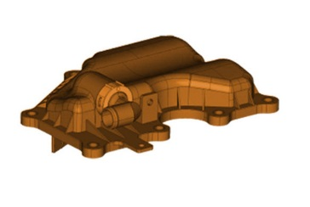
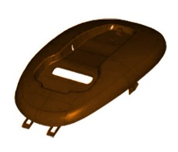
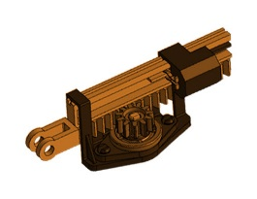
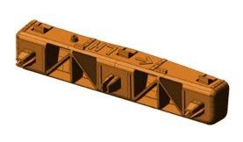
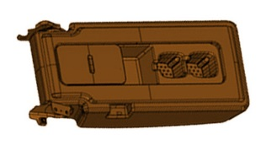
What is Nifco?
We are:
A world-class, advanced automotive components manufacturing business
Making world-class products
For world-class customers

Slide 4
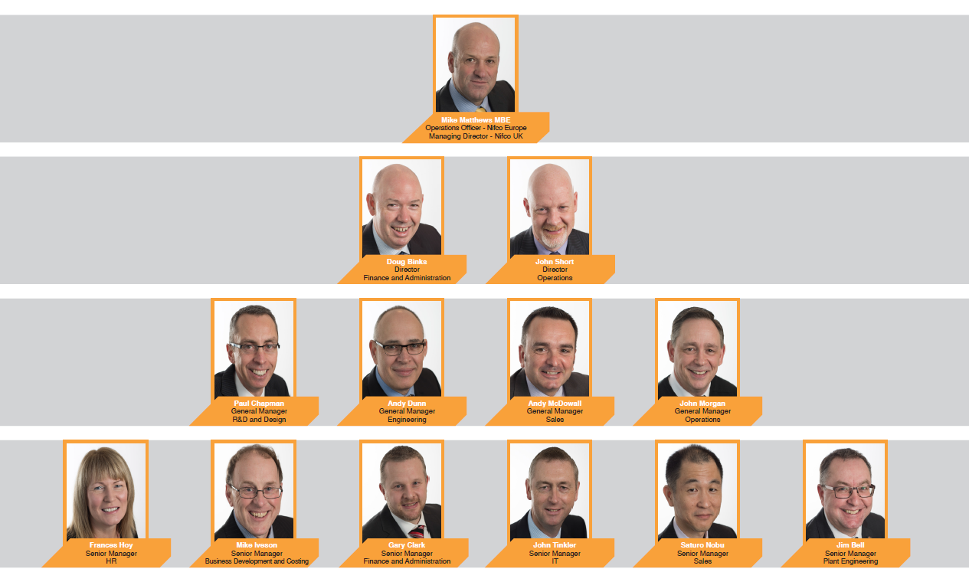
Nifco Career Journey
It started with an apprenticeship…for most of our managers.

Slide 5
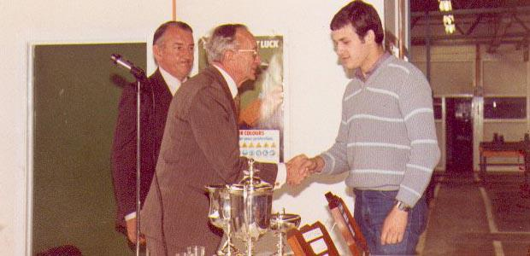
Mike Matthews As An Apprentice
…At Newton Aycliffe

Slide 6
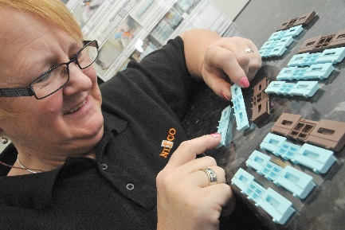
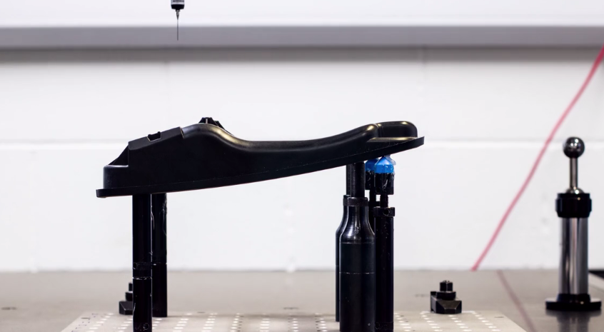
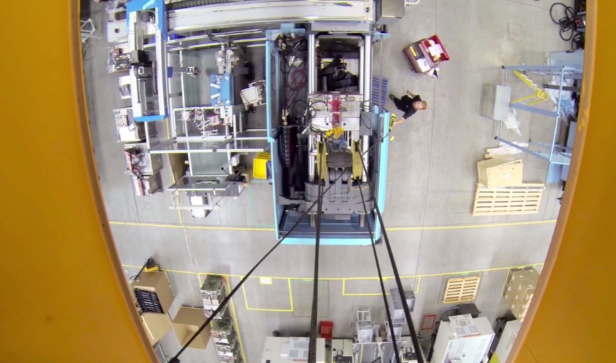
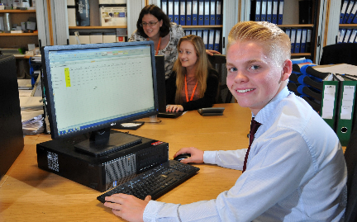
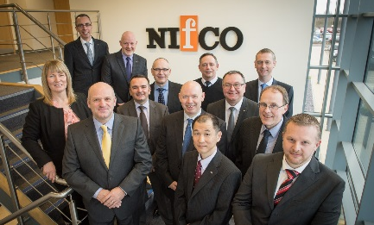
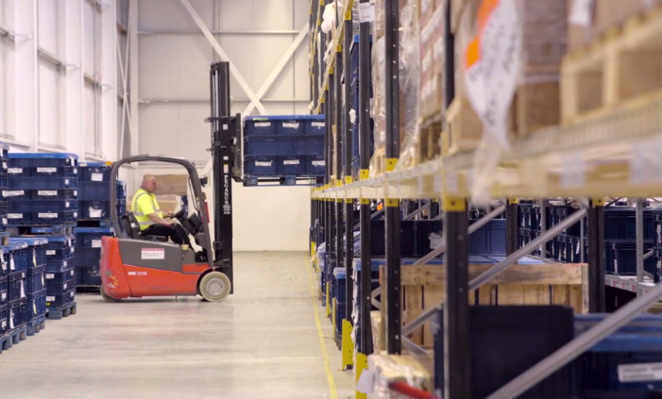
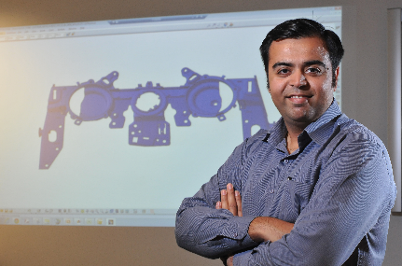
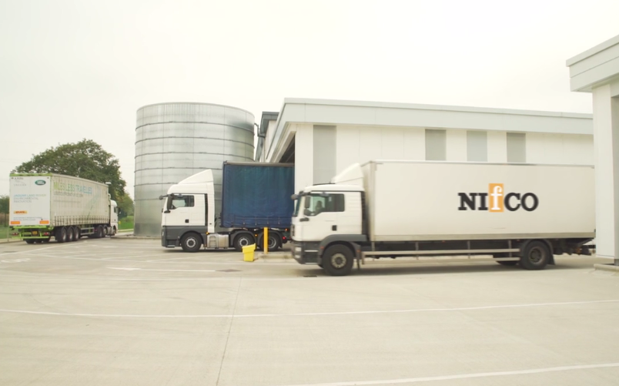
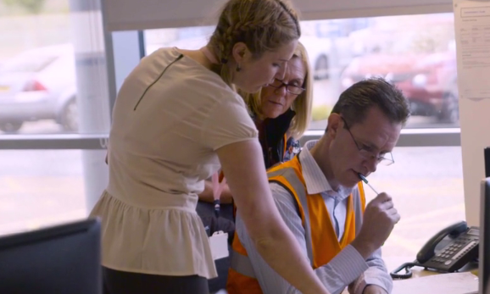
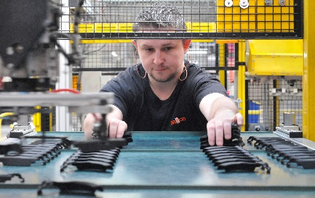
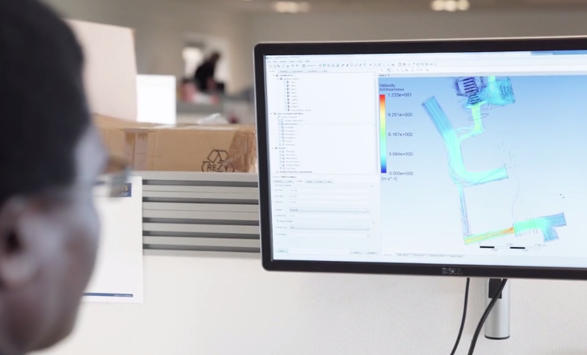
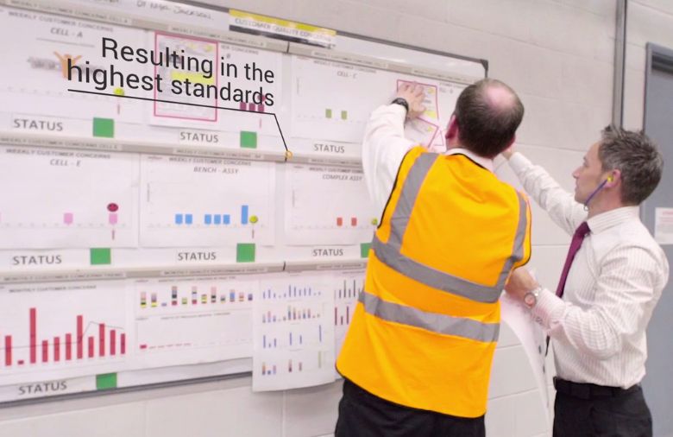
Careers at Nifco
We don’t only have engineers in Manufacturing…
Sales
Design
Purchasing
Engineering
Toolmaking
Maintenance
Moulding
Manual Assembly
Customer Service
Logistics
Stock Management
Marketing
HR
Finance
Management
Quality Control
Health & Safety
Facilities Management
Operations
IT
Communications
Training & Development
…the opportunities are endless!

Slide 7
Nifco Needs Skills
The right person with the basic skills…
10%
Aptitude
90% Attitude
…can become the perfect person!
Industry Understanding
Teamwork
Interview Skills
Communication
Environment
Understanding
Basic Skills
Maths, English, Science
Basic Computer Skills
Job Related Qualifications:
Eg: Engineering, Design etc
Positivity
Computer literate

Slide 8
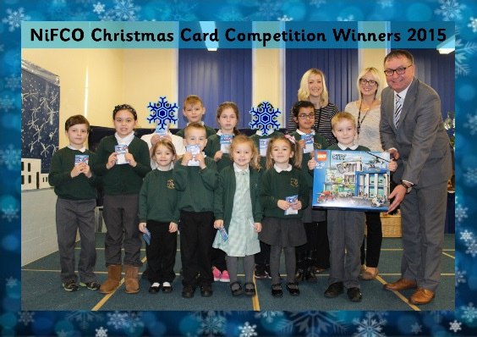
Engaging with Education
We engage with education across a vast spectrum – Primary to Higher Education

Slide 9
Thank you for listening

