Slide 1
Efficiencies: delivering more with less
SCHOOLS NORTHEAST
23rd June 2016
Janis Riley, Helen Lumb
Schools Commercial Team
DfE

Slide 2

Changes in the schools landscape
Growing numbers of academies, Multi Academy Trusts, and changes at Local Authorities with some stopping back office services
Future pressures on schools spending include;
  non-pay inflation
  pay costs
  employer pension contribution increases since September 2015
  national insurance employer contribution increases since April 2016
  Any changes in funding resulting from the new National Funding Formula

Slide 3


New support and guidance
On 12 January the Department launched a package of support on GOV.UK on school efficiency and financial health information, encouraging a three step approach to improvement (https://www.gov.uk/government/collections/schools-financial-health-and-efficiency):
To review levels of efficiency – a new Efficiency Metric
To investigate levels of spend – a new list of top ten governor checks and a new Benchmarking Report Card.
To resolve any issues emerging from this assessment – new videos on collaborative procurement and setting 3-5 year budgets build on existing materials in providing guidance for schools

Slide 4
The 3 main ways to save money
Buying approach | Typical examples include
Buy less of, or not at all | Consume less e.g. energy efficiency lights, lighting systems linked to motion detectors, boiler management, set printers to double sided printing …
Buy the same for less | Aggregate demands e.g. negotiate deals based on your yearly volumes, collaborate with other schools to aggregate demands…
 | Negotiate e.g. use benchmarking data to inform negotiations
 | Change supplier e.g. run a tender competition
Buy something different | Review the specification e.g. is the specification gold plated, are you using or require all of the features, is the service level appropriate or would a lower service level and cost be acceptable
 | Consider alternative products e.g. would a different product provide greater life expectancy and offer a lower whole life cost.
 | Consider a different approach e.g. buy-in a payroll service rather than perform the task in-house

Slide 5

What else can you do?
Analyse expenditure
Review your contracts
Identify opportunities for rationalisation
Deliver admin savings
Collaborate across key strategic spend areas
Benchmark and compare

Slide 6

Why collaborate?
Become an intelligent customer
Achieve procurement efficiencies
Meet deadlines by sharing tasks
Get better services by knowing what works for your schools

Slide 7

Public Sector Procurement – what does it mean for schools?
When spending public money ensure:
fair and open competition/EC Treaty compliance
Public Contracts Regulations compliance
spending public money means you are accountable to UK Courts and European Commission
For all Schools current thresholds are:-
£164,176 Goods & Services
£4,104,394 Works
“light touch” regime for services under £589,148
Regulations do not apply in full when the estimated contract value is below threshold
But the Treaty principles do

Slide 8
Public Sector Buying Organisations (PSBOs)
Some of the organisations we work with:
Central Buying Consortium (CBC)
Crescent Purchasing Consortium (CPC)
Crown Commercial Service (CCS)
Eastern Shires Purchasing Organisation (ESPO)
North Eastern Purchasing Organisation (NEPO)
YPO
Notes:
8

Slide 9
Risk Protection Arrangement (RPA)
RPA is NOT insurance
Government managing risk in line with HM Treasury policy as set out in ‘Managing Public Money’
£25 per pupil fixed until August 2016
Available for all academy trusts and multi academy trusts to opt in as an alternative to insurance
Latest RPA headline figures 16 June 2016:
2536 academies have opted in; of which
2415 are live as at 16 Jun 2016, 121 will start RPA cover at a later date in 2016
This represents 44.4% of all open academies (5715)

Slide 10

RPA - more information
Find out more about the Risk Protection Arrangement, including the claims management and risk management approach here:
https://www.gov.uk/academies-risk-protection-arrangement-rpa
Membership Rules set out the full scope of the RPA and can be found here:
https://www.gov.uk/government/publications/risk-protection-arrangement-rpa-for-academy-trusts-membership-rules
Cover helpdesk and advice line is available to all academies
RPAAdvice@willis.com Phone: 0117 9769 361
Other related RPA queries
Academies.RPA@education.gsi.gov.uk;

Slide 11


Schools Energy Efficiency
What have we achieved so far?
Invested £32 million of capital through the Salix Energy Efficiency Loans scheme
Provided over 670 schools and academies with interest free loans for energy efficiency projects with projected lifetime savings of £63 million
Further £6.2 million funding through the EFA 2016/17 Conditions Improvement Fund (CIF) https://www.gov.uk/guidance/condition-improvement-fund
Established schools page on the Salix website www.salixfinance.co.uk/schools

Slide 12
Microsoft MoU for Schools
Delivers savings of c. £10m per annum by way of discounts and preferential terms and conditions
Covers all Microsoft software licensing needs for UK schools
The 2016 MoU is flagged as a transition agreement – Microsoft benefits from June 2018 will be mainly aimed at cloud services
Make sure your re-seller offers the MoU discounts and concessions
Ask for quotes from more than one supplier
https://www.gov.uk/government/publications/buying-for-schools-microsoft-memorandum-of-understanding
Notes:
12

Slide 13
Cloud Software Services
Major providers to schools are all either “cloud-based” or heading that way fast
Cloud offers savings opportunities but is not a cure-all
DfE is to publish “best practice” guidance for schools wishing to migrate to the cloud
DfE maintains some Cloud and Data Protection guidance where suppliers have responded - https://www.gov.uk/government/publications/cloud-software-services-and-the-data-protection-act.
The Department also provides Model Privacy Impact notices at https://www.gov.uk/government/publications/data-protection-and-privacy-privacy-notices
Notes:
13

Slide 14
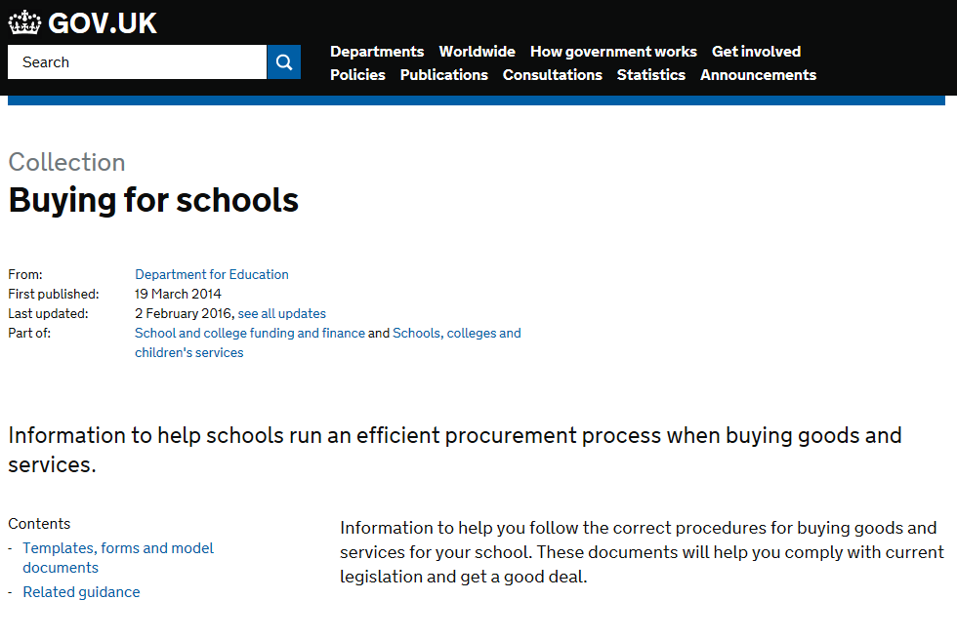
Buying Guidance
https://www.gov.uk/government/collections/buying-for-schools
Further help provided on procurement issues by contacting CG.Communications@education.gsi.gov.uk

Slide 15

Crown Commercial Service
Jointly developing a work programme to support school procurement and efficiency including:
  Energy
  Multi Function Devices (MFDs)
  Technology for Education
  Facilities Management
  Banking Services
Notes:
15

Slide 16



Energy for Schools
DfE/CCS collaboration working with academy focus groups
Offer launched in March 2015
Average savings 10% but evidence of further savings on broker fees
Single supplier on each framework so no need for mini competition
Further enhancements planned for 2016
https://www.gov.uk/government/publications/energy-for-schools

Slide 17


Photocopiers/Printers (“MFDs”)
“By using the new RM1599 framework the school is saving 90% on the new Xerox MFD agreement plus over 80% on the service contract.”
Benthal Primary School
By switching to our MFD framework, Jack Tizard School is saving 39% on their colour printing, that’s over £1,300 per year
3,130+
Customers To Date
Education
All Lots
“This deal delivers big savings and peace of mind – certainly best value. I’ve recommended it to other business managers and they’re seeing great results.”
Business Manager
Fitzjohn’s Primary School
50%
Average Price Savings
Education
Lot 1
£43.5 million
Spend To Date
Education
All Lots
“We’re saving £939 a year, that’s 54%”
Victoria Infant & Nursery School

Slide 18
Technology for Education
Replacement for the old BECTA agreement, created in collaboration with DfE and EFA
Specifically tailored to meet schools’ ICT requirements
4 year Framework running until April 2019
21 approved suppliers that have:-
  knowledge and experience of delivering educational solutions
  been evaluated via an EU compliant competition process
  have signed up to pre-determined contractual t’s & c’s
  subjected to contract and performance management
Suitable for maintained schools, Local Authorities, Free Schools and Academies.

Slide 19


Under development…
Facilities Management
Provide an innovative and extensive contracting vehicle giving academies access to:
  Total facilities management
  Hard FM services
  Soft FM services
Banking Services
Many schools have moved to cashless payments and electronic parent communication.
  CCS agreement includes schools within scope
  The aim is to reduce transactional costs for schools

Slide 20


Procurement training for schools
Improve school procurement skills to support better buying outcomes
Twelve 15 to 45 minute sessions complete with trainer notes:
  supports a train the trainer approach to allow SBMs and finance staff working in partnership to drive procurement capability
Cover the key principles of cost-effective buying
Develop an understanding of public sector procurement law and how it applies to schools
Encourages clusters and groups to share effective practice
For more information to share at your next SBM meeting or if interested in leading a local group, contact helen.lumb@education.gsi.gov.uk

Slide 21


Our journey
GOOD
Facilitator led
Real Life examples
Active
You do it
What would you do?
BAD
Bamboozled by experts
Theoretical
Passive
Watch me
Here’s how to use it

Slide 22
Training AIDE
Analysis – what are the needs and priorities for your group?
Impact – what is the outcome you want?
    Better and smarter buying? or
    Create savings by finding better deals? or
    Keep out of trouble by knowing the rules?
    ALL 3 - GREAT!
Determine – how you want to deliver?
    1 facilitator or split your group to present to each other?
Evaluate – has the training met your objectives
    What are the group taking away?
    What are the groups next steps?

Slide 23


How the modules work
Bitesize session, each taking an overview of a simple public procurement cycle
Follow the same format, majority contain an activity – need an idea for an INSET day perhaps or governor meeting?
Designed to be fun but thought provoking!
Designed to create discussion which may lead to further collaboration.

Slide 24
Assess – is it working?
Immediate
    Hands up what did people think?, will this be used back in school?
    Marks out of 10
      How much was the session enjoyed?
      How much could work in school?
      How much will make a difference in school?
  Informal
    Group discussion
    Quick telephone call
    Interview key staff – what are they doing differently?
Formal
    Collaborative focus group
    Survey
    Cluster spend analysis?

Slide 25

Initial modules https://www.gov.uk/government/publications/procurement-training-for-schools
  1. Cost not price
  2. Analysing value
  3. Collaboration
  4. Creating a specification
  5. Finding Suppliers
  6. Tender
  7. Negotiation
  8. What is a contract
  9. Contract management
  10. Risk management
  11. Leasing
  12. Procurement legislation

Slide 26
Networks – we want you!
Great work being done in some areas of the country
We’ve met many local groups – but there are many we still aren’t aware of and would like to meet!
A platform for all - SBMs and back office staff only - use as a forum, for advice, collective buying and sharing expertise.

Slide 27
Shaping deals to better meet your needs delivers real benefits. Schools who participate find the process informative.
We require a bigger pool of schools to work with us, if you are interested, please email: Schools.ICTSUPPORT@education.gsi.gov.uk
Any questions?
janis.riley@education.gsi.gov.uk
helen.lumb@education.gsi.gov.uk

